Slide 1
The Age of Exploration
Collapse of Inca/Aztec empires, birth of the slave trade, all for the expansion of wealth

Slide 2
The Age of Exploration
The Three G’s (No, not the name of my Rap group)
Vasco de Gama-
1st explorer to go around Cape of Good Hope (horn of Africa) to get to India
Ferdinand Magellan- circumnavigated the globe
Christopher Columbus- “discovered*” the Americas
God, Gold, and Glory
*For some reason most textbooks define the word “discovered” as: enslaved, killed, pillaged from vibrant existing cultures

Slide 3
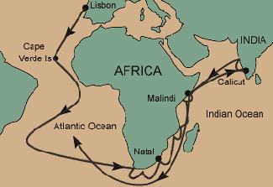

Slide 4
Conquistadors
Hernando Cortes conquered the Aztecs (Indians dominated Mexico before Spanish came in 16th century)
Francisco Pizarro conquered the Incas (South American Indians who lived in the Andes, around Peru and Ecaudor, Macchu Picchu)
Conquistadors succeeded due to advanced weapons, horses, disease!

Slide 5
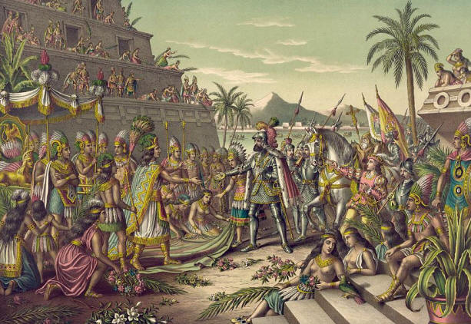

Slide 6
The Slave Trade
Atlantic slave trade- between 1500 and 1600, nearly 300,000 Africans were transported to the Americas. During the 17th century, that number climbed to 1.3 million. By the time Atlantic slave trade ended in 19th century, Europeans had imported about 9.5 Africans to the Americas
African rulers/merchants would captured Africans to be enslaved, then sold to Europeans for gold, guns, and other goods

Slide 7
The Slave Trade
Causes- Europeans “needed” resources, cheap labor (more like FREE labor), workers
Effects- Population in Africa decreased in Africa, violation of human rights
Triangular trade: Europeans transported manufactured goods to West Coast of Africa, traders exchanged goods for Africans, Africans were transported across Atlantic and sold in West Indies, Merchants brought sugar, coffee, and tobacco in the West Indies and sailed to Europe with these products.
Middle passage- trade route from West Africa to West Indies, CRUEL, about 20% of Africans dies during brutal trip

Slide 8
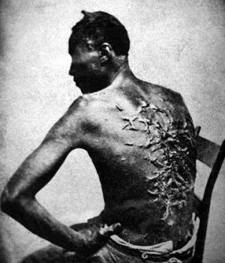

Slide 9
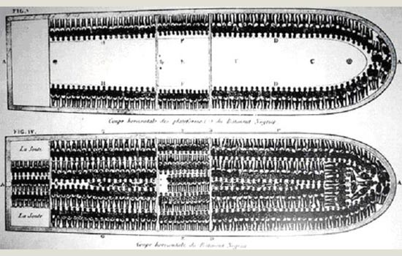

Slide 10
Effects of Slave Trade
Introduced guns to Africa
African families torn apart
Introduced long standing African populations with culture (art, music,

Slide 11
Columbian Exchange
Goods from Americas: corn, potato, sugar, pineapple, avocado, cocoa bean
Goods from Europe: livestock (horses, sheep, pigs, cattle), bananas, grapes, coffee, DISEASE- YUMMY!
Mercantilism: exporting more than you import to maximize your profit
Colony sends money, raw materials to parent country. Parent country sends goods for sale!

Slide 12
Mercantilism- theory that held that a country’s power depended mainly on its wealth. Attain as much wealth (gold/silver) to maintain a favorable balance of trade- selling more goods than you buy.
Joint-stock company- like modern corporation, investors buy shares of stock in a company, combine wealth for a common purpose
Economic changes spurred growth of towns and a rising class of merchants
Increased wealth of European nations, mercantilism led to creation of a national identity and expansion of the power of European monarchs

Slide 13
ABSOLUTISM
Philip II- promoted Divine Right theory, admired by Machiavelli (The Prince is about Philip II), leads Spain in creating their colonial empire
Louis XIV- the “Sun King”, extravagant lifestyle left France in debt (Palace of Versailles), “I am the State”
Peter the Great- Westernized Russia, meaning he made Russia more European (food, clothes, education)
Enlightened despot- Catherine the Great
Glorious Revolution
Magna Carta (1215) limited power of the King, English Bill of Rights (1689) made England a Constitutional Monarchy!

