Slide 2
Scientific Revolution- time when there was a change in Scientific thought
Copernicus- Heliocentric theory, Polish astronomer who became interested in old Greek idea that sun was at the center of the universe (heliocentric) 1543
Galileo- built telescope in 1609 to study heavens. Published book in 1632 that supported Copernicus. Inquisition threatened him with torture, Galileo signed confession, lived rest of life under house arrest
Newton- English scientist who published Laws of Motion, described laws of gravity, published in 1687

Slide 3
Scientific Revolution changed the way Europeans looked at the world because it continued the questioning spirit of the Renaissance and challenged the church
Scientific led to the Enlightenment because it was questioning institutions that had held sway during middle ages (church, monarchy)
If natural laws governed the way the physical world worked, then humans were given natural rights. This would influence NEW POLITICAL IDEAS of questioning the king’s DIVINE RIGHT.

Slide 4
Enlightenment: intellectual movement of a shift in European thoughts on politics
John Locke- English thinker, Natural rights: Life, liberty and property. Influenced Thomas Jefferson. Wrote Treatise of Government.
French Philosophes:
Montesquieu- separation of powers in government, branches of government (legislative, judicial, executive) checks and balances
Voltaire- freedom of speech, separation of church and state, “I do not agree with what you have to say but I will fight to the death for your right to say it”
All of these Enlightenment thinkers were going against Thomas Hobbes who believed in ABSOLUTE MONARCHY and DIVINE RIGHT theory

Slide 5
The Enlightenment’s impact- INFLUENCED ALL OF DEEZ!
American Revolution (1776-1781)
French Revolution (1789-1799)
Revolutions in Latin America (Haitian (1791-1801), Revolutions in South Murica (1817-1824), Mexican Independence (1821)

Slide 6
The French Revolution
Political: King Louis XIV, poor leadership
Social: Estates
1st: Clergy
2nd: Nobility
3rd: EVERYONE ELSE 98% (from mid class Bourgeoisie to peasants)
Economic: France in Debt from helping in American Revolution, opulent spending (Versailles)
Third Estate pays all taxes

Slide 7
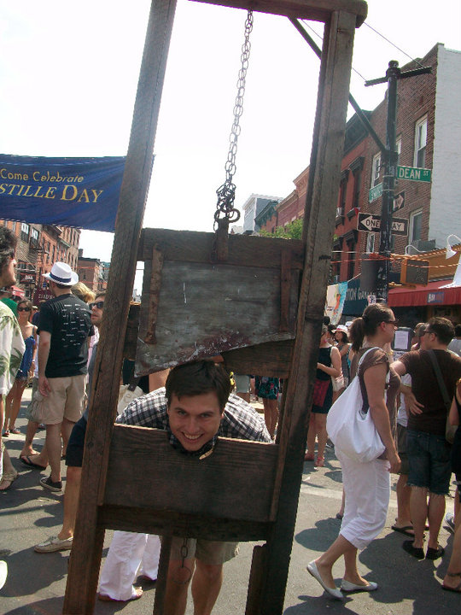

Slide 8
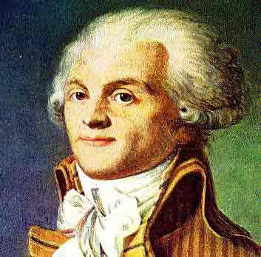
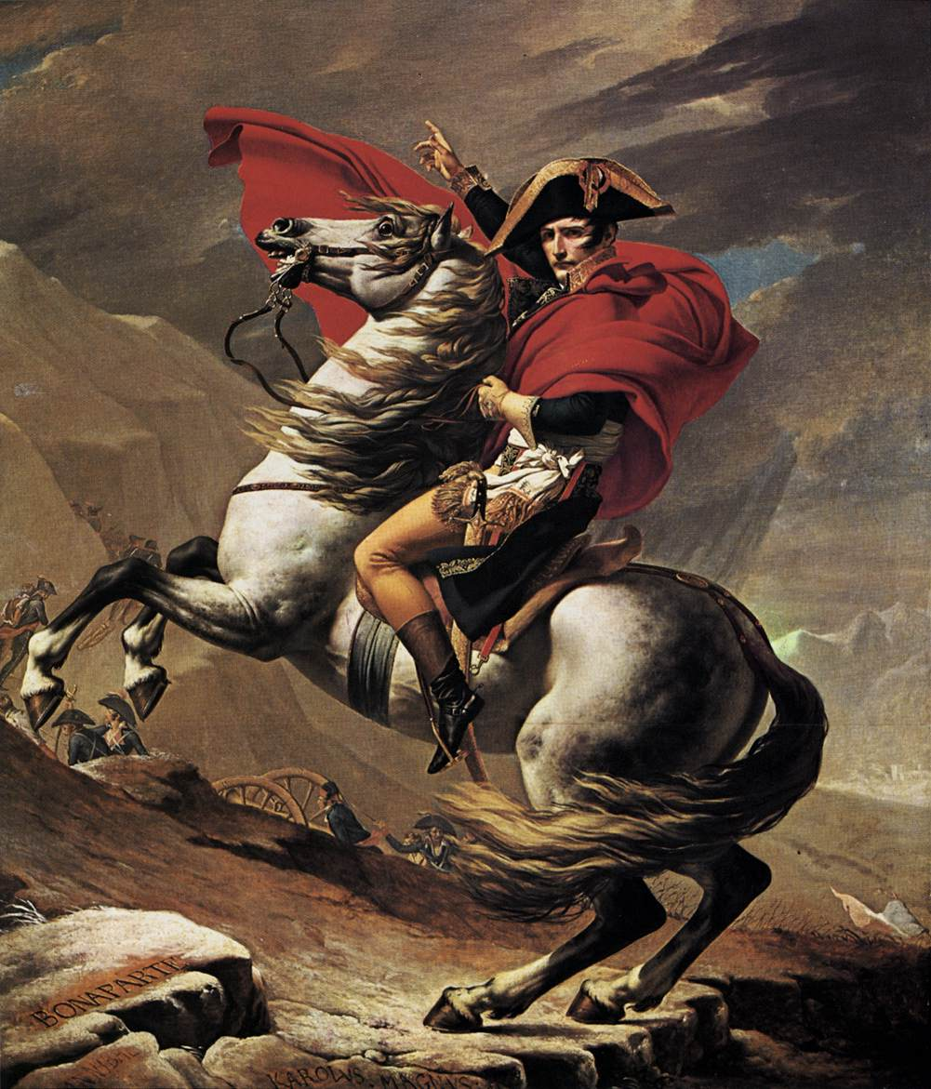
> Storming of the Bastille
> Tennis Court Oath
> Reign of Terror (Robespierre)
> Napoleon
Napoleonic Code: limited certain rights to recreate order, mandating education
Napoleon- inspired NATIONALISM, intense pride in one’s country

Slide 9
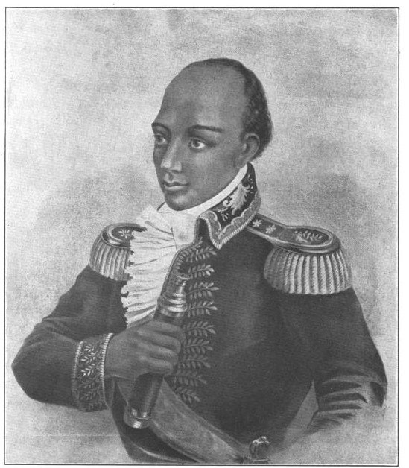
Latin American Revolutions
American and French revolutions inspired those in Latin America
Toussaint L’Ouverture
Led Haitian revolution against France
Was a former slave
Simon Bolivar- wealthy Venezuelan Creole (Spanish born in Latin America) who led South American Revolution against Spain, gained independence
Along with Jose de San Martin, an Argentinian, they drove the Spanish out and the future countries of Venezuela, Colombia, Panama, and Ecuador were united as Gran Colombia

